Slide 1

Build intelligent apps with WinUI, Windows AI Foundry & Windows AI APIs
Alvin Ashcraft
Sr. Content Developer - Microsoft
Notes:
Welcome to TechBash 2025 and my session on the new Windows AI APIs in the Windows App SDK.

Slide 2
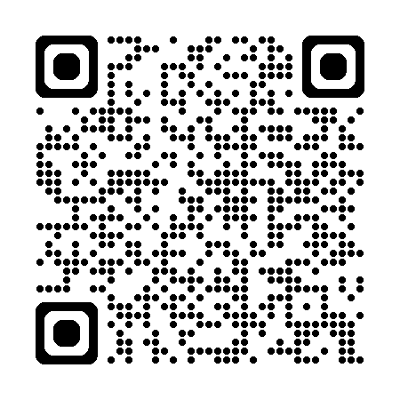
About Me
Software industry for nearly 30 years
Morning Dew link blog
Three books for Packt Publishing
Content developer at Microsoft since 2022
TechBash dev conference organizer since 2016
Slides & demos:
Notes:
A little background about me…
For those who don’t know me, I’ve been in the software industry since 1995, with most of that time (over 25) years spent as a developer and architect using various Microsoft technologies.
Some of you may also be familiar with my blog, the Morning Dew, where I’ve been posting daily links for .NET developers since 2007.
I also have three books from Packt Publishing with a fourth on the way. You can check those out on Packt’s website or on Amazon. Just search for my name.
Writing those books led me to pivot my career to technical writing. I joined Microsoft about three and a half years ago as a content developer. I write documentation, training modules, and code samples on Microsoft Learn. I work on the Windows developer docs team, helping to maintain the docs for client apps and APIs. I have another talk I give about my work as a content developer and how anyone can contribute to content on Learn through GitHub issues and PRs.
Finally, I’m one of the founding organizers of the TechBash developer conference. We’ve been running the event right here in the Poconos since 2016.

Slide 3

Agenda
AI Options for .NET Developers
WinUI and Windows App SDK
Copilot+ PCs, Windows AI Foundry, and Phi Silica
The Windows AI APIs in Windows App SDK
Text Recognition APIs
Recall in Windows – Where does my app tie in?
The AI Dev Gallery app for Windows
Q&A
Notes:
Here’s what I plan to cover today. We’ll go a little deeper in some areas than others, based on how baked each of the features are.
Things are moving fast, and the AI landscape for .NET developers is evolving quickly.
We’ll briefly touch on WinUI and Windows App SDK, just to level-set and make sure everyone understands what they encompass.
Then we’ll try to untangle somethings that were announced and updated over the last year and a half:
Copilot+ PCs are devices optimized for local AI workloads with an NPU and Phi Silica is the local model on those PCs. The first models had Arm processors, but Intel and AMD have their own NPU-based models across multiple manufacturers now too.
Windows AI Foundry encompasses the local Windows AI features and hosts local AI models.
The Windows AI APIs are a set of APIs in the Windows App SDK that leverage the local Phi Silica model found on Copilot+ PCs.
Windows ML is another set of APIs and features in the Windows App SDK for accessing other types of local AI models in Windows AI Foundry. Machines without an NPU can also use these APIs.
After wading through those evolving topics and crossing our fingers through some demos I updated this week, we’ll look at the text recognition APIs in Windows App SDK.
Most of you have probably heard of the oft-delayed Windows Recall feature that the team is working hard to make sure has enough security and responsible AI features included for grandma to find her forgotten recipes without exposing her bank account information.
We’ll wrap up by looking at the open-source AI Dev Gallery app that you can download from the Store. It’s got WinUI and other .NET sample apps and tools to help download local models. The team has worked hard to make it easy to use and an example of how to build a great-looking WinUI app for Windows 11.

Slide 4

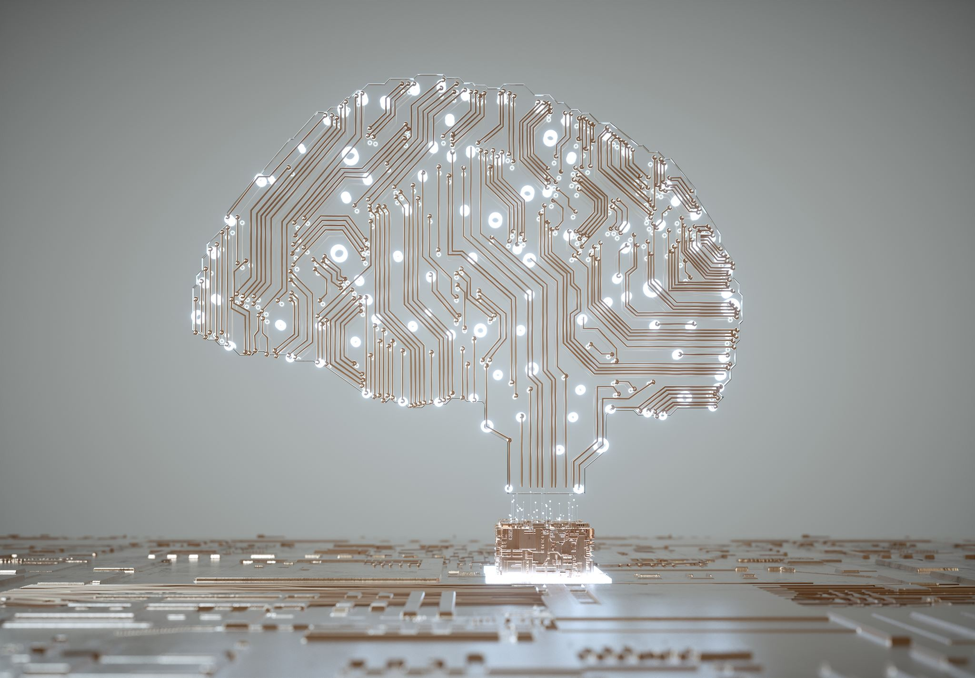



AI Options for .NET Developers
Microsoft.Extensions.AI libraries for .NET.
Semantic Kernel – Build agents and consume models with C#, Python or Java.
C# SDK for Model Context Protocol (MCP)
AI Toolkit for VS Code.
GitHub Copilot in Visual Studio and VS Code.
Azure AI Foundry & Windows AI Foundry
Windows AI APIs
Notes:
In this section, we'll explore various AI options that are specifically designed for .NET developers. This includes tools, frameworks, and best practices that can streamline the integration of AI into your existing applications.
The Microsoft.Extensions.AI libraries were created to help .NET developers consume AI services. We won’t get into details, as this isn’t the focus of my talk, but they include libraries for:
Requesting or streaming chat responses.
Calling tools (functions or APIs) as part of a chat request (like providing a specific weather call to use in a prompt request).
Caching responses
Using telemetry
Chat options
Functionality Pipelines (builder pattern familiar to ASP.NET devs – ChatClientBuilder)
Middleware – composition with sub client for things like rate limiting
Dependency injection for easily swapping out AI services in config
Security and content safety
Evaluation APIs for determining the accuracy and quality of responses from AI services and models
We also won’t be exploring Semantic Kernel today, but it’s got libraries for .NET, Python and Java developers to simplify building AI agents and consume models. Its core concepts are:
Connections: for working with AI services and data sources
Plugins: for building functions that massage your prompts or responses
Planner: for orchestration of complex AI workflows
Memory: for AI context management
The C# SDK for MCP is new and evolving quickly. Keep an eye on this, but by the time .NET 10 ships and Microsoft Ignite pops up, anything I tell you now might be very different. At a bird’s eye view, MCP is the standard for defining interfaces between AI producers and consumers. It aims to ensure your AI apps can seamlessly connect to any AI service or data source. The C# SDK is building APIs for clients and servers.
The AI Toolkit is a plugin for VS Code a growing feature set.
Model catalog (GitHub, ONNX, OpenAI, Anthropic, Google, and more)
Bring your own model (local or cloud)
A Playground for model inference or testing with a chat UI
Attachment support for working in multi-model scenarios
Running prompts in batches
Evaluate or fine tune a model with your own datasets
Agent Builder (formerly known as Prompt Builder) – generate C# or Python code from your prompts
Convert models to ONNX format. Local models in AI Toolkit must be in ONNX format. AI Toolkit can convert models it downloads from Azure AI Foundry, Hugging Face, and other sources.
Check out the AI Toolkit docs on the VS Code docs site.
There are tons of AI productivity tools like GitHub Copilot in Visual Studio and VS Code. I’m also a big fan of the Warp AI terminal.
There are cloud platforms like Azure AI Foundry and now local platforms like Windows AI Foundry. This is where we’ll be starting shortly.
And finally, the Windows AI APIs, formerly known as the Windows Copilot Runtime APIs that are included in the latest Windows App SDK experimental releases.
Let’s talk about Windows App SDK and WinUI in some more detail…

Slide 5

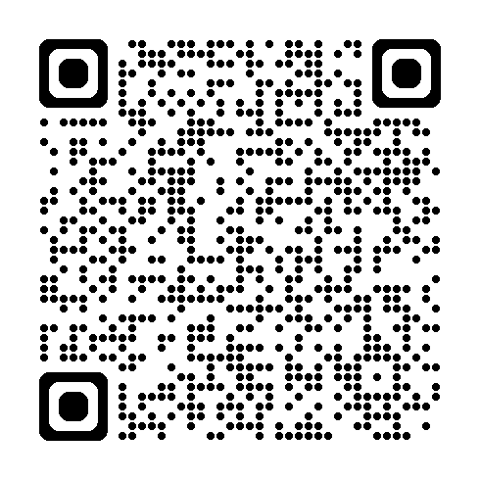
WinUI and Windows App SDK
Understand the benefits of WinUI for modern applications.
Learn how Windows App SDK enhances app development.
Access .NET 9, WinRT APIs, and Windows App SDK APIs in WinUI apps.
Get started on Microsoft Learn:
Notes:
We’ll cover the advantages of using WinUI in your application development. We will also discuss how the Windows App SDK can enhance the overall development experience and what features are available when using Windows App SDK for building apps with AI features.
If you haven’t created apps with WinUI before, it’s the same XAML schema as UWP apps. It’s similar enough to WPF or .NET MAUI to pick make the adjustment easily. In fact, if you’ve deployed a .NET MAUI app to Windows, that’s a WinUI app under the covers. It’s Microsoft’s recommended UI framework when you’re building native apps for Windows, assuming the current feature set meets your requirements. It hasn’t been around as long as WPF and WinForms, so there are still a few areas where they excel.
WinUI is part of the Windows App SDK and receives updates with its releases. In addition to containing the WinUI UI components, the SDK contains an API set similar (but not as extensive as) the Windows Runtime (or WinRT) APIs that UWP uses.
Many of those WinRT APIs are still accessible to packaged WinUI apps (or any packaged desktop app for that matter). It’s a topic for another talk, but WPF and WinForms apps packed with MSIX can use most of the non-UI APIs in both Windows App SDK and WinRT. There are articles in the Windows developer docs on Microsoft Learn about how to configure your apps to use these different SDKs.
As far as WinUI is concerned, your apps out of the box can use .NET 8 or 9 APIs, Windows App SDK APIs, and most of the WinRT APIs. Keep in mind that when using the WinRT APIs, you have the same constraints as UWP apps and Windows versions. You must specify a minimum Windows SDK version and target version to determine the set of APIs your app can use.
Each release of Windows App SDK is closing the gap with WinRT, so there are fewer and fewer reasons for WinUI developers to dip into the Windows SDK.
The QR code here will take you to the docs on getting started with WinUI. We’ll see some code shortly when we open our first WinUI project that uses the Windows AI APIs.

Slide 6
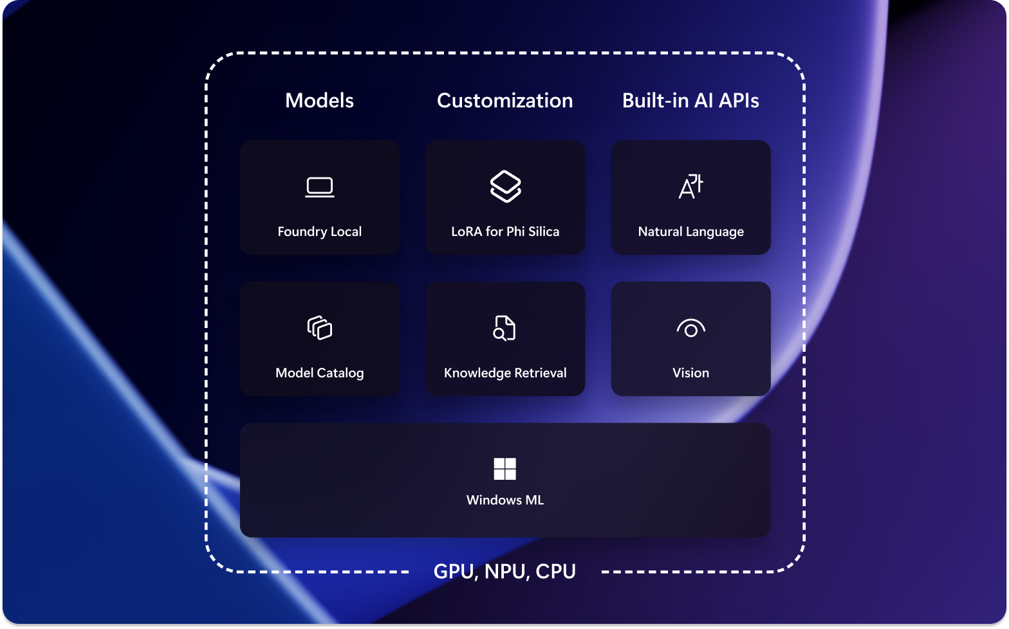
Copilot+ PCs and Phi Silica
Introducing Copilot+ PCs and their integration with Windows development tools.
What’s the role of Phi Silica on Windows Copilot+ PCs?
NPU-tuned local model
Practical applications of Windows AI Foundry and Windows AI APIs:
Local model
OCR
Imaging
Content moderation
Notes:
Here, we will provide an overview of Windows Copilot+ PCs and their significance in development environments. Additionally, we will explore how Phi Silica contributes to performance improvements and what that means for developers.
Copilot+ PCs are Windows PCs that include a neural processing unit (NPU) for power-friendly, AI processing performance. The first Copilot+ PCs all had Arm-based CPUs (Qualcomm Snapdragon X Elite and X Plus models), but additional models with Intel Core Ultra 200V and AMD Ryzen AI 300 series CPUs were announced later last year.
These PCs include but aren’t limited to Surface Pro and Surface Laptop devices. Dell, Lenovo, and other manufacturers have their own Copilot+ PCs available in different form factors.
These PCs provide the ability to run apps and features with local AI models while maintaining exceptional battery life. The Phi Silica local language model is Microsoft’s model that ships with the OS and integrates with features like Recall and the AI features being built into Notepad, Microsoft Paint, and AI powered search in Windows, File Explorer and the Photos app.
With the Windows AI APIs in Windows App SDK, your apps can query the Phi Silica model and leverage other features like OCR, imaging and content moderation/safety. Third party apps can also use Search APIs to opt-in to providing results in Windows Search. I just helped the Cloud Files API team update some docs on how providers like Dropbox, Box, or Google Drive can use these APIs in preview to show your files in the cloud in Windows Search results.
Let’s talk about some more API specifics next…

Slide 7

Windows AI APIs in Windows App SDK
Overview of the Windows AI APIs.
Utilize these APIs in your Windows apps: WinUI, WPF and Windows Forms!
Demo time:
WinUI app
Query local model
Moderation filters
Notes:
In this section, we will delve into the Windows AI APIs available through the Windows App SDK. We will cover how to effectively use these APIs in your projects and show some examples of their use in a small project I created for this demo.
You can use these AI APIs in any packaged desktop app that includes the Windows App SDK package reference. Right now, you need to use the latest experimental release… Windows App SDK 1.8 Experimental release 2.
Let’s get to the demo where we’ll see code in a WinUI app to query the Phi Silica local model on my Copilot+ PC. I’ll also show you the moderation filters that are available to restrict different types of risky input or output.
Let’s finally get to some code…

Slide 8

Text Recognition APIs
Text recognition capabilities.
Image Super Resolution (smart scaling) and Segmentation.
Demo
WPF app with scaling and text recognition (WinUI app for backup)
Load image (supports file picker or paste)
OCR to produce text
Use local model to explain the text
Notes:
Now we’ll focus on text recognition APIs, their functionalities, and potential applications. We will also go over coding examples to illustrate how these APIs can be incorporated into your Windows desktop apps.
So, the text recognition APIs used in the app we’ll see can OCR text from an image we select and then use the local model to analyze the detected text to summarize what’s there.
This time, we’re using a WPF project that’s referencing Windows App SDK’s 1.8 experimental 1 release. I also have a WinUI version of the project in case we have issues. The imaging project loads an image, runs an OCR scan on it to get the text and then uses the AI APIs to analyze and summarize the text.
Let’s go…

Slide 9
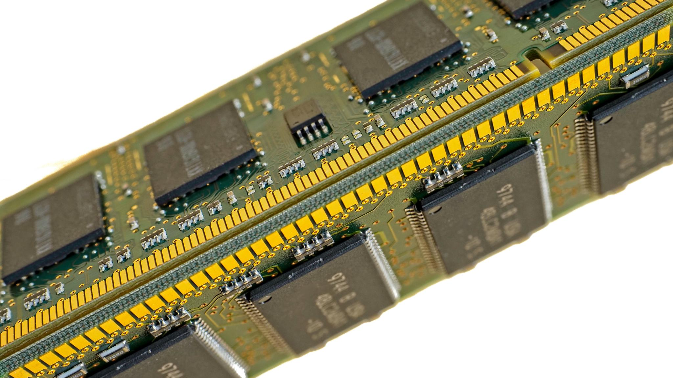
Recall in Windows & Integration with Your Apps
Windows Recall integration options in Windows apps.
Opt-in feature only available on Copilot+ PCs.
Enhance user experience in Recall:
Launch Click to Do – Use URI ms-clicktodo://
Search Recall for images related to your app
Use UserActivity APIs to record specific app data related to saved snapshots.
APIs still in experimental state and evolving.
Notes:
In this final section, we will explore how Recall can be integrated into Windows applications. We'll discuss the importance of the principles of responsible AI and share best practices to enhance the overall user experience in your apps.
Since it’s initial introduction, Microsoft has updated Recall quite a bit. One of the biggest changes is making it an opt-in feature. It’s not enabled by default on supported PCs. Users can also use the Recall settings to exclude apps and sites from being included in Recall’s screenshots.
Part of Recall is a feature called Click to Do. This feature presents an overlay on your screen with options to:
Copy text
Open selected text with the app of your choice
Search the web with the selected text
Open a URL from the selected area
Email an email address from the selected area
Copy/save/share/open a selected image
Perform a visual search on Bing with the image
Blur or remove a background
Erase objects in the selected image
Any app can launch Click to Do with the clicktodo URI. You can even put the URI into your browser to launch it.
In the future you’ll be able to allow users search the Recall snapshots for any information recorded for your app.
You can also use the UserActivity class to record additional information along with the screenshots captured while your app has focus. This extra metadata can make it easier to either search or provide more data back to your app’s users later when they view the snapshots.

Slide 10
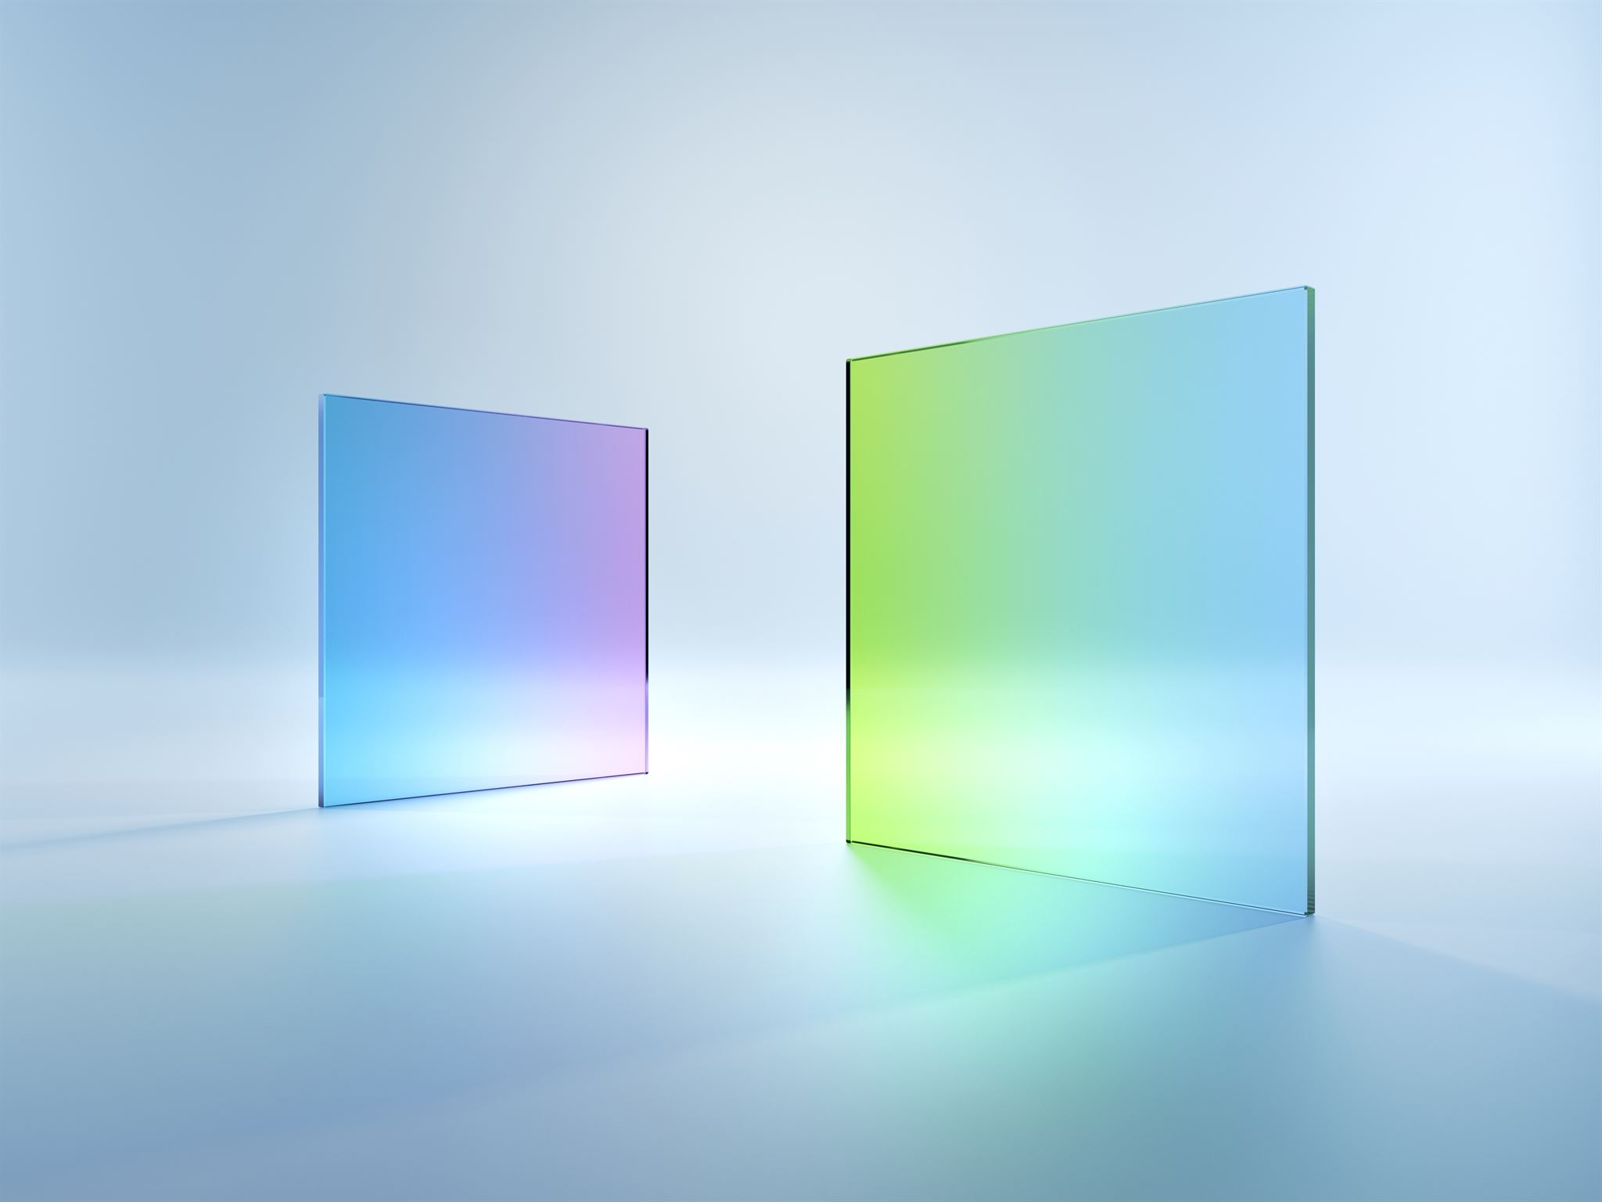
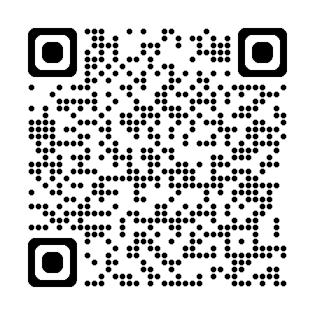
AI Dev Gallery App for Windows
AI Dev Gallery – Get it in the Microsoft Store.
Over 30 interactive local AI sample apps.
Discover and download local models.
Open source on GitHub:
Notes:
Here we'll introduce the AI Dev Gallery app for Windows, highlighting its features and available resources. Look at how to provide feedback and contribute to the app on GitHub.
The app is available on the Microsoft Store, and the code is open source on GitHub. Use the QR code on screen to check out the repo and run it from source locally.
It now has over 30 sample apps that you can explore and run on your machine. Some are apps that use Phi Silica, but many others can run on any Windows PCs. The samples that require a Copilot+ PC are easily identified in the left navigation in the app.
You can also use the gallery to download and use different local AI models.
Let’s open the app can explore a bit. If we have time, we’ll also take a quick look at the source code.

Slide 11

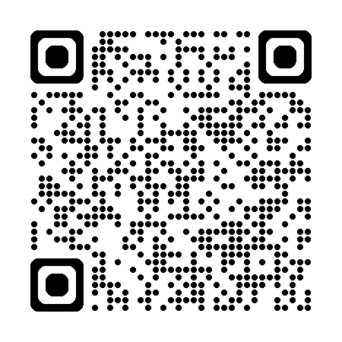
Q&A
Any questions?
Contact me: alvin@alvinashcraft.com
Learn more in the Windows AI docs on Microsoft Learn:
Notes:
Any questions? Feel free to reach out via email or any social media platform. Or come talk to me at TechBash in November!
You can get this slide deck and my code samples on my “speaking” GitHub repo.

